Slide 1
Graph AI for Biomedical Databases - (Review PPT)
COURSE: NOSQL DATABASES (CSE3086)
NAME: HARSHINI – 19MIA1050

Slide 2
Motivation •
Rising advent of several diseases has taken a major toll on the society.
It disrupts many families, causes enormous economic losses and perhaps forever changes our behavior. As a result, it raises our awareness of the public health issue. It becomes immediately clear that we the human race need to invest more in the medical research to avert the next calamity.

Slide 3
01
• PROBLEM STATEMENT •
Biomedical research has a very promising future. Apart from the fact that it may detect the present diseases lingering in the society, it may also provide a possible route to mitigate the same.
This project, done via graph database platform Neo4j, aims to provide adequate information with respect to the diseases, concerned drugs as well as causative pathogens.

Slide 4
METHODS AND TOOLS USED
02
Database
Methods – I
Neo4j, a NoSQL/ graph database application would be used throughout the project.
Includes basic visualization and querying, generation of insights and conclusions.
Data(set)
Methods - II
Kyoto Encyclopedia of Genes and Genomes (KEGG) database, that contains a list of pathogens, drugs and diseases.
ML procedures such as GraphSAGE as well as a possibilty of a drug recommendation system.
Miscellaneous
Programming/Querying Languages used
Google Colab, Jupyter Notebook, Py2Neo library
Cypher Query Language, Python (optional)

Slide 5
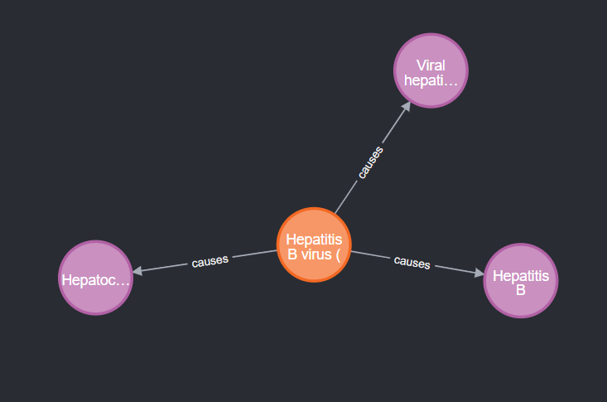
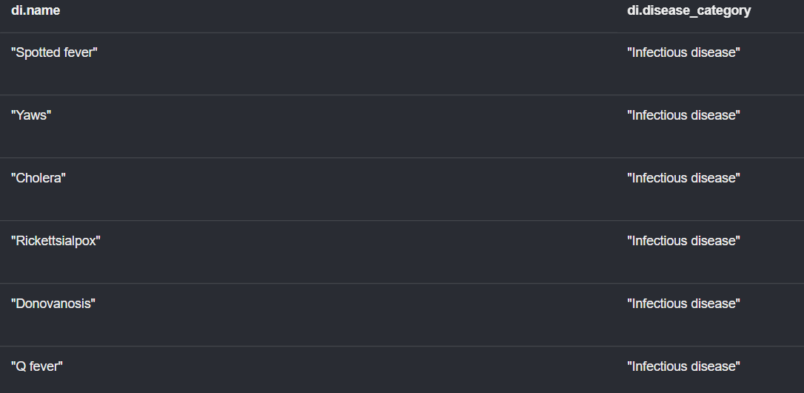
(Some screenshots from initial stages of project development)

Slide 6
REFERENCES
03
Smalheiser, N. R., & Cohen, A. M. (2018). Design of a generic, open platform for machine learning-assisted indexing and clustering of articles in PubMed, a biomedical bibliographic database. Data and information management, 2(1), 27-36.
Singh, A. V., Rosenkranz, D., Ansari, M. H. D., Singh, R., Kanase, A., Singh, S. P., ... & Luch, A. (2020). Artificial intelligence and machine learning empower advanced biomedical material design to toxicity prediction. Advanced Intelligent Systems, 2(12), 2000084.
Kimball, J. (2021). basicML: machine learning basics for working with biomedical data.
Dheyab, H. F., Ucan, O. N., Khalaf, M., & Mohammed, A. H. (2020, October). Implementation a Various Types of Machine Learning Approaches for Biomedical Datasets based on Sickle Cell Disorder. In 2020 4th International Symposium on Multidisciplinary Studies and Innovative Technologies (ISMSIT) (pp. 1-6). IEEE.
Mirza, B., Wang, W., Wang, J., Choi, H., Chung, N. C., & Ping, P. (2019). Machine learning and integrative analysis of biomedical big data. Genes, 10(2), 87.

